Slide 1
CS 449 Rec 6
Slides are available at https://github.com/wenyuli08/CS449_Rec_Fall2020

Slide 2
Midterm due today @ 6:00 pm

Slide 3
Schedule
Scope & lifetime
gdb
Bomb lab

Slide 4
Scope: “Where a name can be seen”
Global scope
Can be seen everywhere in any file
File scope
Can be seen only in current file
Function prototype scope (for C)
Declared in prototype, so only visible in prototype
Int addition(int a, int b);
Function scope
Block scope
{} indicates a block in C
The “local”

Slide 5
Lifetime: “The time between allocation and deallocation”
In other words, it’s how long a variable’s memory is valid
For simplicity, we divide it into Global and Local

Slide 6


int glob = 0; int main() { int m = 10; func(); return 0; }
void func() {
int f = 10;
}
(Program start) | Main running | Func running | Main running | (Program ends)
time

Slide 7
Be careful: pointer variables and whatever they point to have separate lifetime
char* func() {
char str[50] = "hello world";
return str;
}
int main() {
char* str = func();
printf("%s\n", str);
return 0;
}
What’s the lifetimes of these variables?
Char *str
Char str
What does this print?

Slide 8
Conclusion/Difference (briefly describe)
Examples that a variable is within scope but not lifetime
Examples that a variable is within lifetime but not scope

Slide 9
Quiz (1/3)
pushq %rbp
movq %rsp, %rbp
movq %rdi, -24(%rbp)
movl %esi, -28(%rbp)
…
popq %rbp
ret
What is it doing?
How many args?
What (types) are they?

Slide 10
(2/3)
movl $0, -8(%rbp)
.L3:
movl -8(%rbp), %eax
cmpl -28(%rbp), %eax
jge .L2
addl $1, -4(%rbp)
addl $1, -8(%rbp)
jmp .L3
.L2:
What is it doing?
(L2 is whatever happens right after it)

Slide 11
(3/3)
foo(int*, int):
pushq %rbp
movq %rsp, %rbp
movq %rdi, -24(%rbp)
movl %esi, -28(%rbp)
movq -24(%rbp), %rax
movl (%rax), %eax
movl %eax, -4(%rbp)
movl $0, -8(%rbp)
.L3:
movl -8(%rbp), %eax
cmpl -28(%rbp), %eax
jge .L2
addl $1, -4(%rbp)
addl $1, -8(%rbp)
jmp .L3
.L2:
movl -4(%rbp), %eax
popq %rbp
ret
What is it doing now that you have the whole picture?

Slide 12
int foo(int *p, int val) {
int ret = *p;
int i;
for (i = 0; i < val; i ++) {
ret ++;
}
return ret;
}

Slide 13

What could this be?
.L3:
movl -4(%rbp), %eax
cmpl -28(%rbp), %eax
jge .L2/jg…
(…)
jmp .L3

Slide 14
The Intel Syntax (bomb lab)
foo(int*, int):
push rbp
mov rbp, rsp
mov QWORD PTR [rbp-24], rdi
mov DWORD PTR [rbp-28], esi
mov rax, QWORD PTR [rbp-24]
mov eax, DWORD PTR [rax]
mov DWORD PTR [rbp-4], eax
mov DWORD PTR [rbp-8], 0
.L3:
mov eax, DWORD PTR [rbp-8]
cmp eax, DWORD PTR [rbp-28]
jge .L2
add DWORD PTR [rbp-4], 1
add DWORD PTR [rbp-8], 1
jmp .L3
.L2:
mov eax, DWORD PTR [rbp-4]
pop rbp
ret

Slide 15
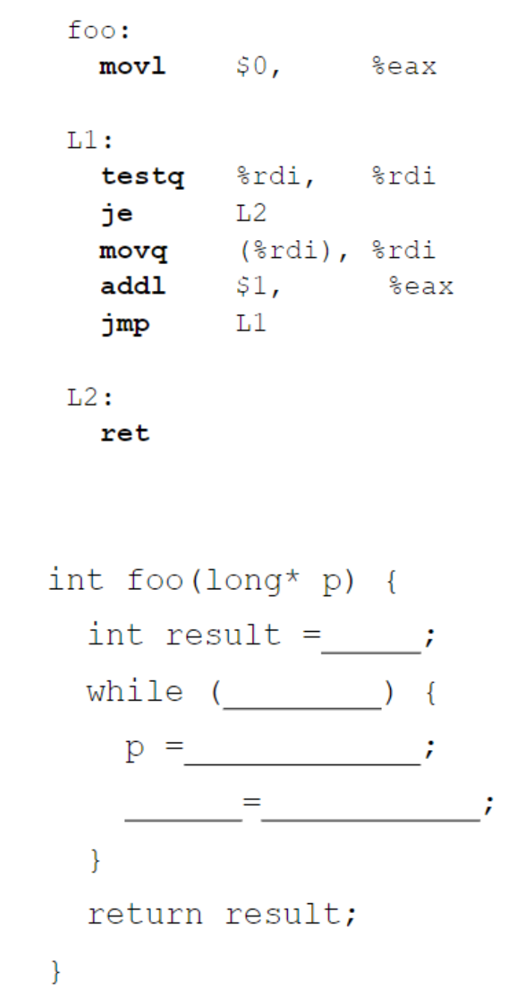
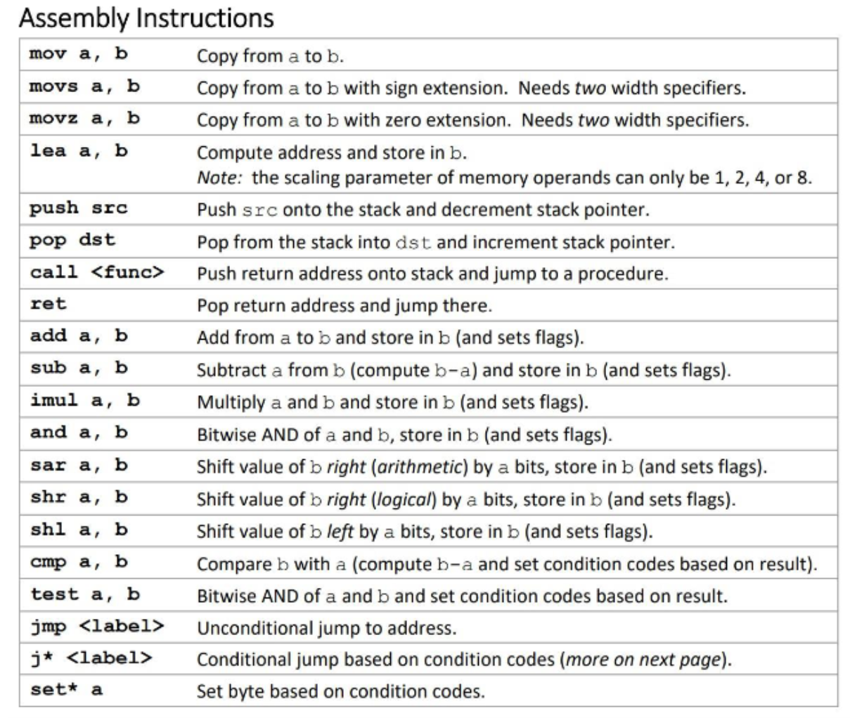

Slide 16
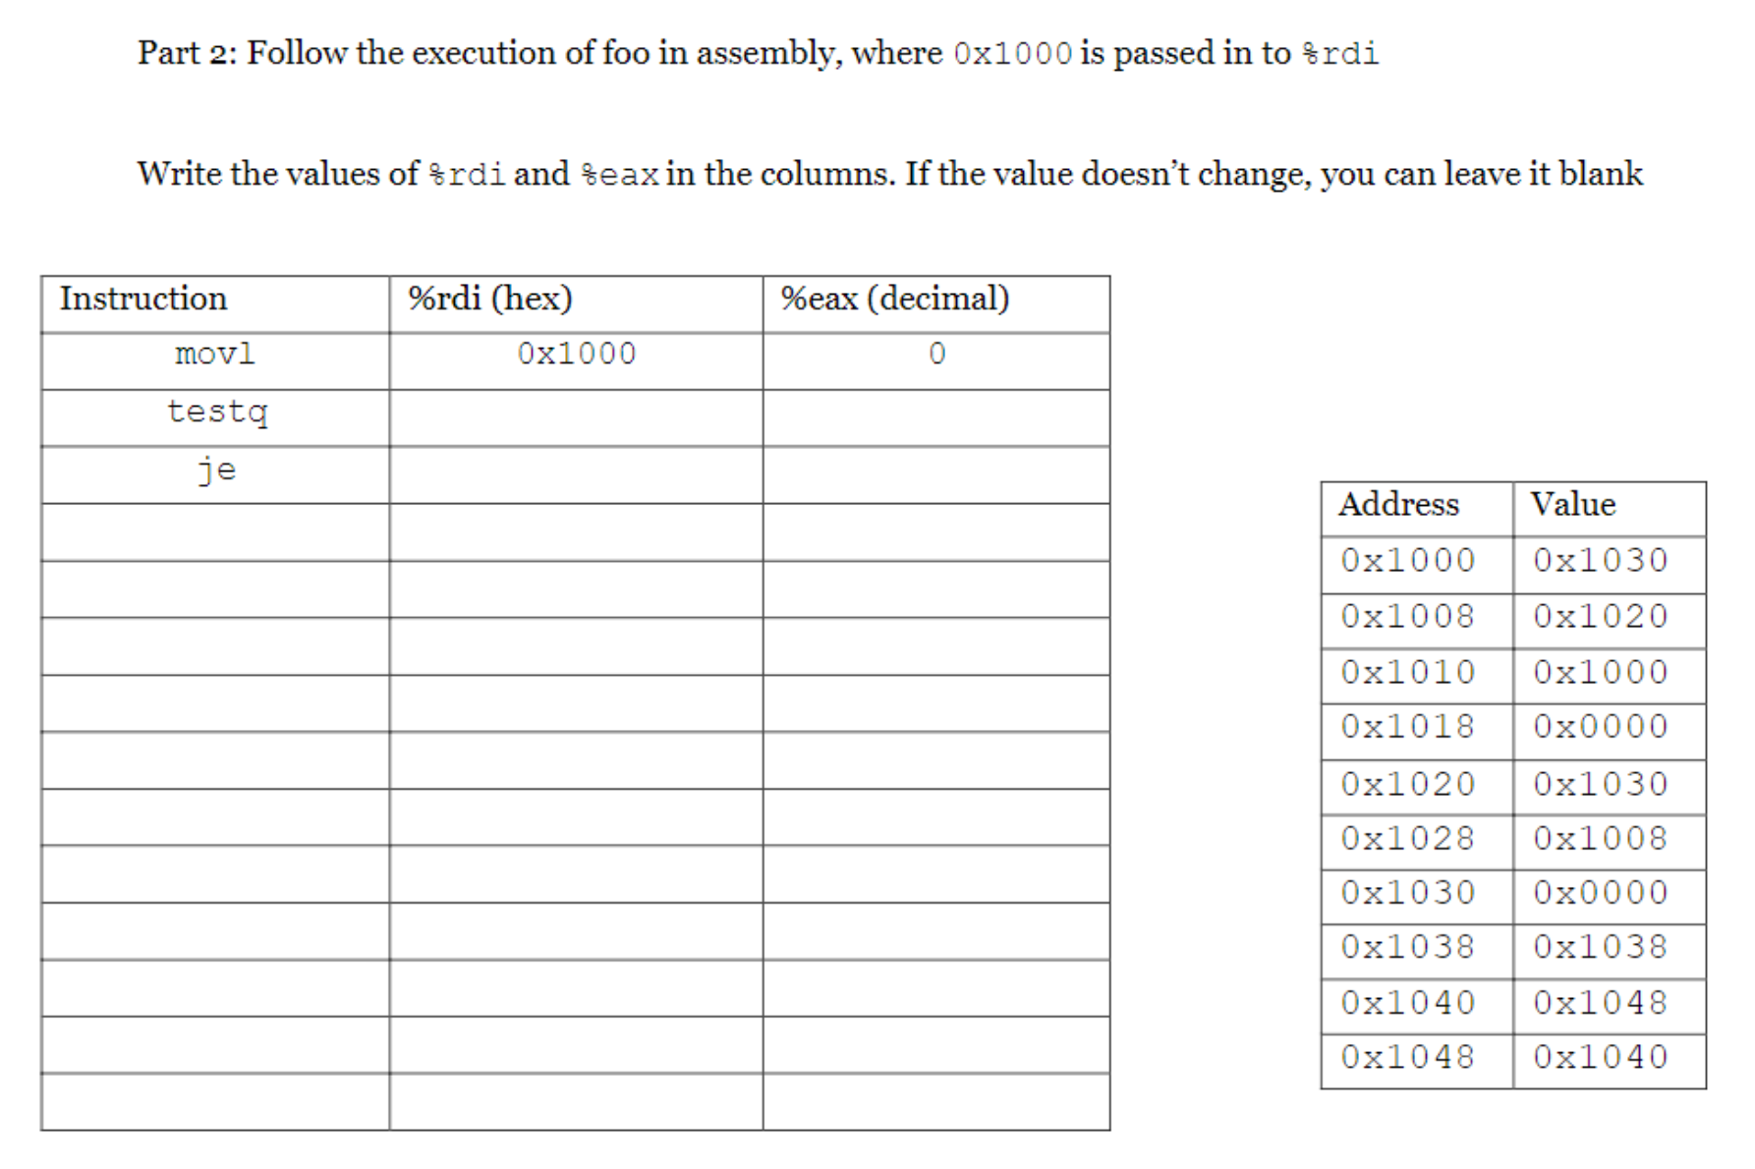
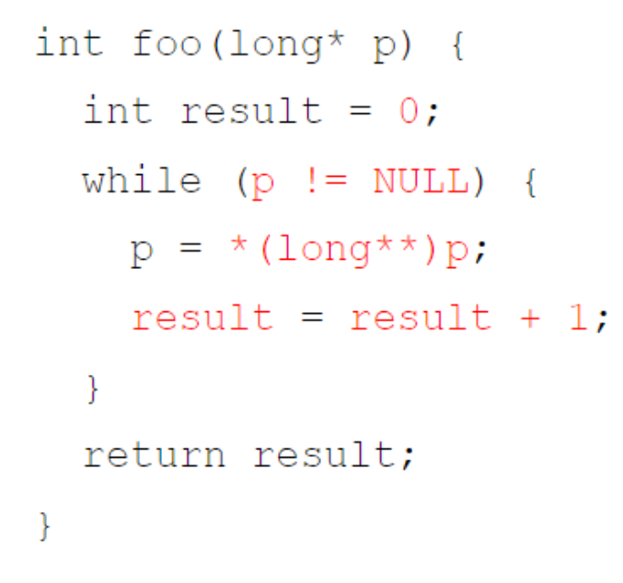

Slide 17
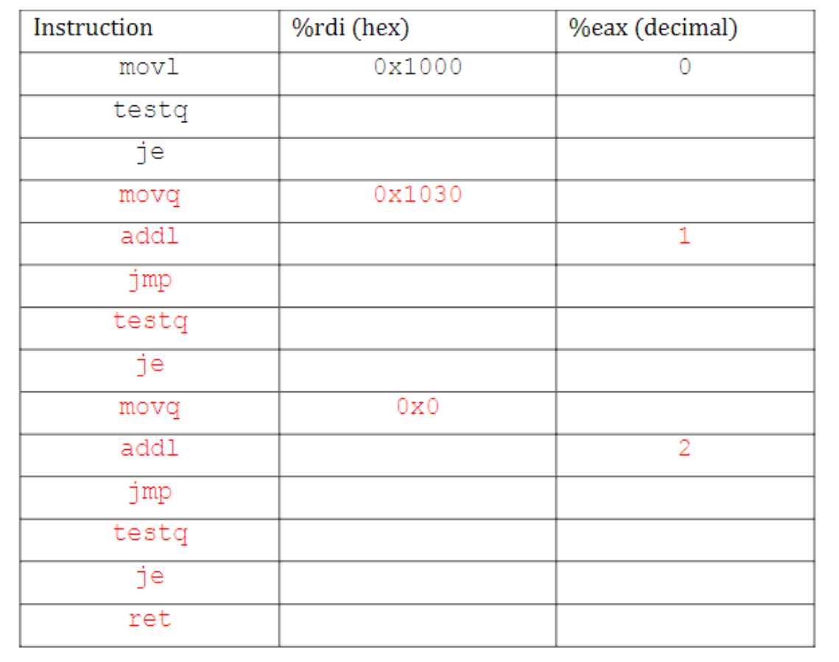

Slide 18
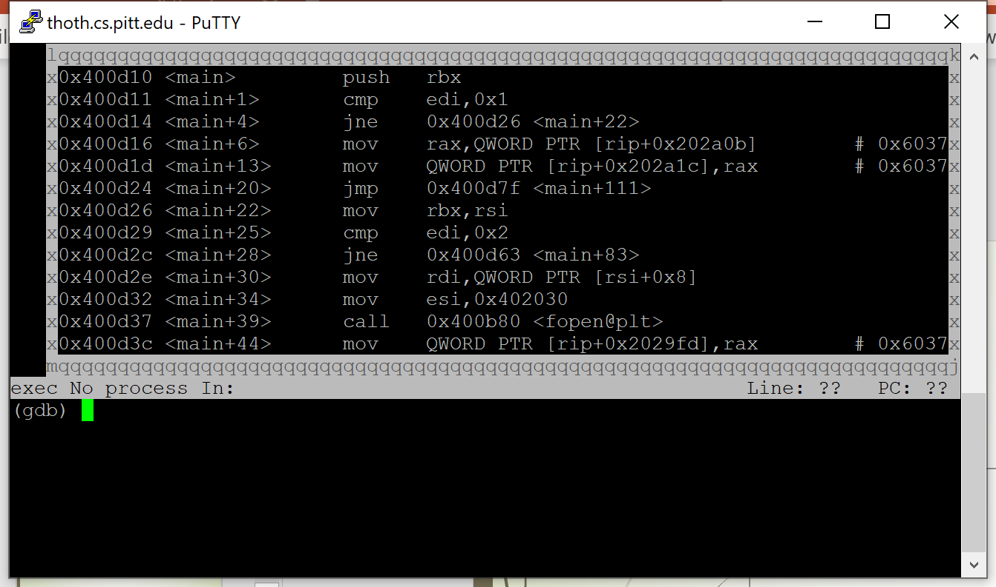
GDB (basics in rec 1)
layout next lets you see the code as you step through (at the beginning)
Don’t do this during defusing
Close it with ctrl+X+A

Slide 19
Read the pdf: Hints, where to start?

Slide 20
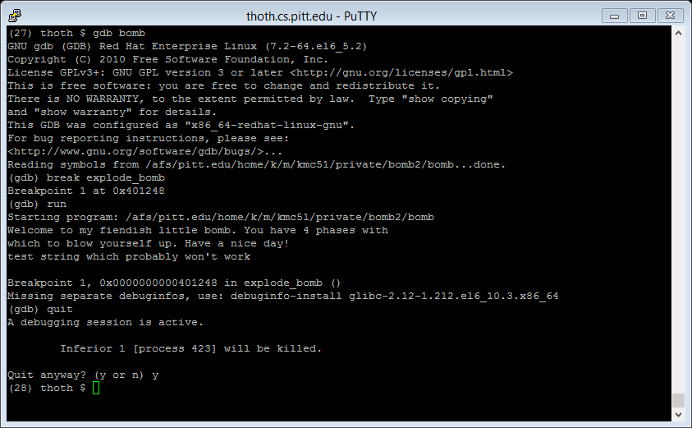
Useful break points to set
Break explode_bomb (for all phases)
…not_equal/…compare/…
Break … if cond
Break printf(“bad news”)

Slide 21
Useful strings to search for (for simple bomb)
“Phase 1 defused. Cool. How about the next one?” / “Awesome! That's number 2. Keep going!” / …
Especially near compare/if statement

Slide 22
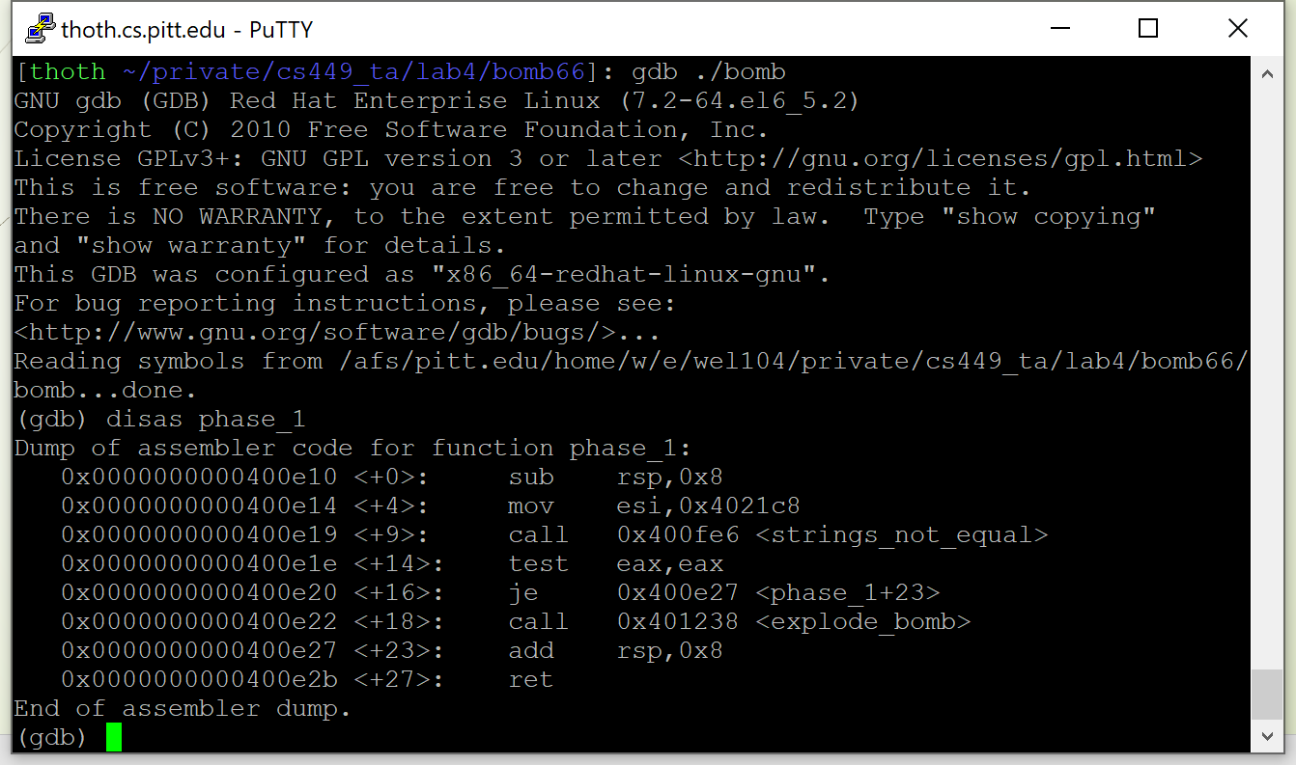
Disas = disassembly

Slide 23
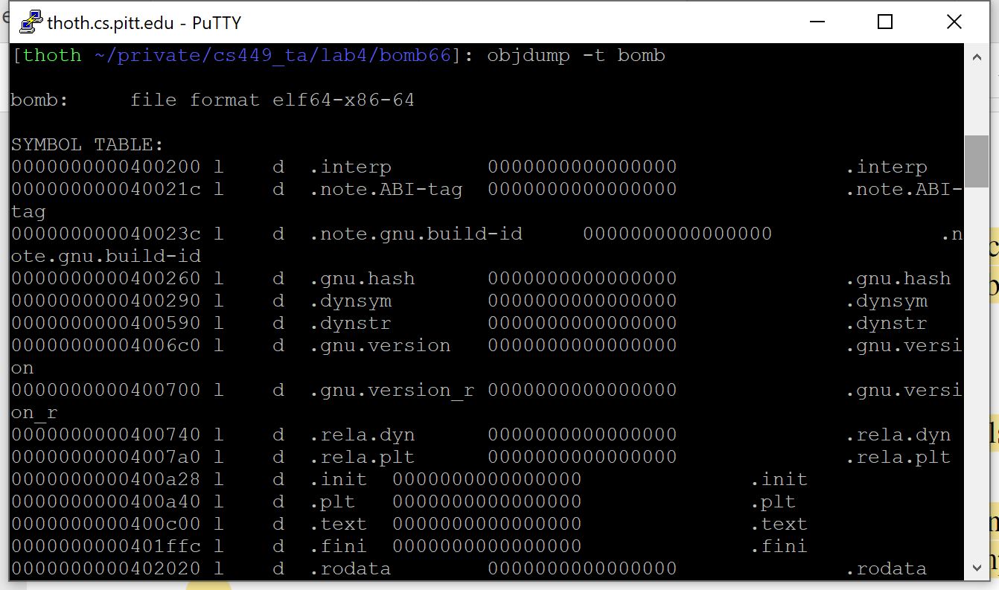
Objdump, strings, apropos, info, man… (called directly)

Slide 24
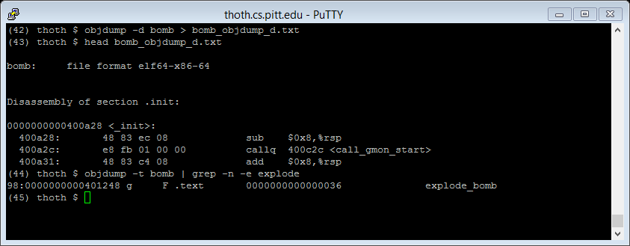

Slide 25
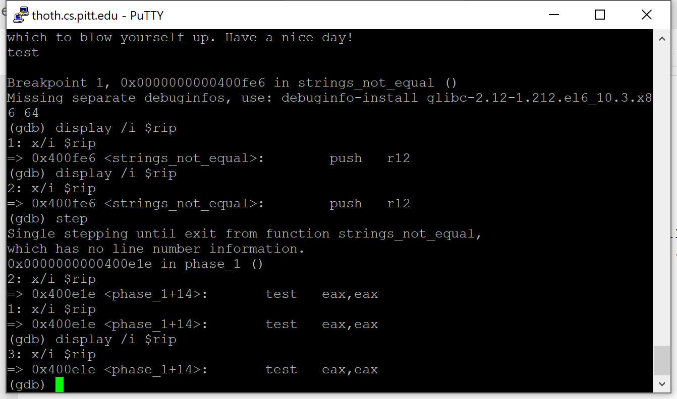
Stepping through and displaying next step

Slide 26
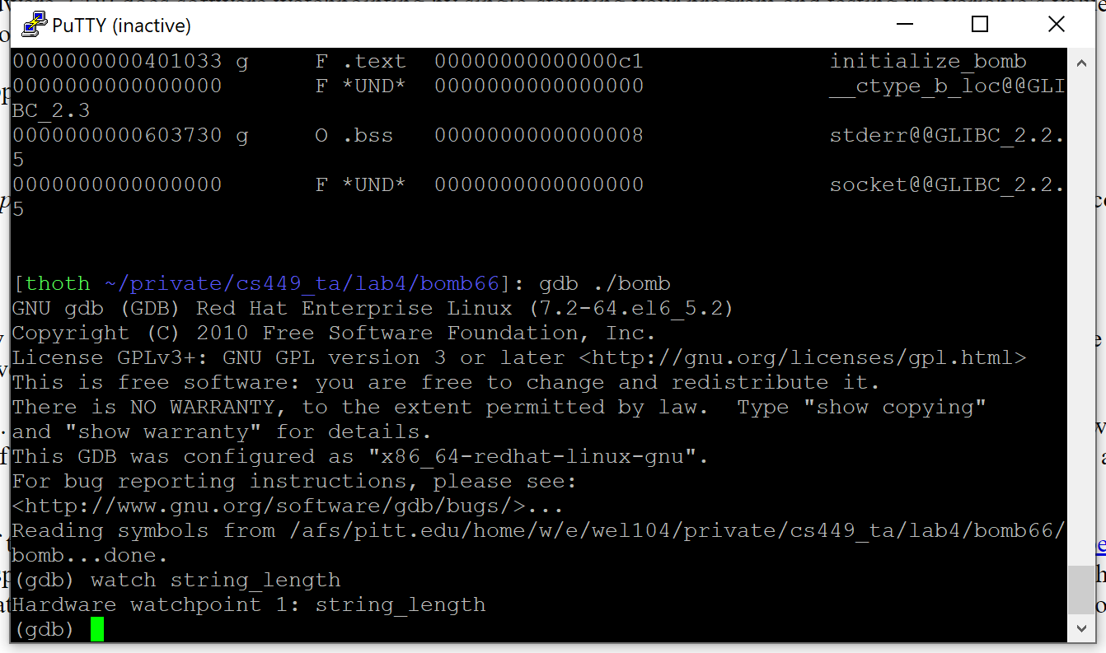
Watch point pause the program whenever the value changes

Slide 27
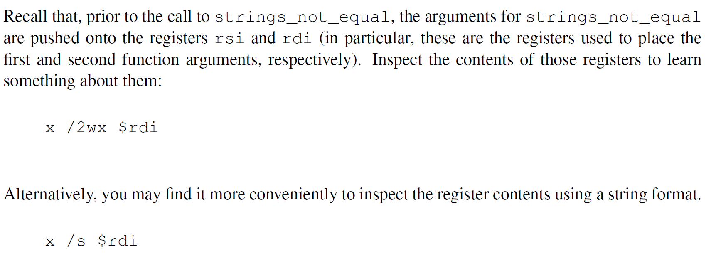
Or print
Or x/s

Slide 28
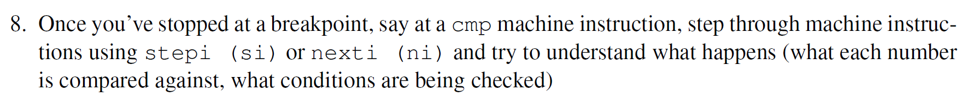
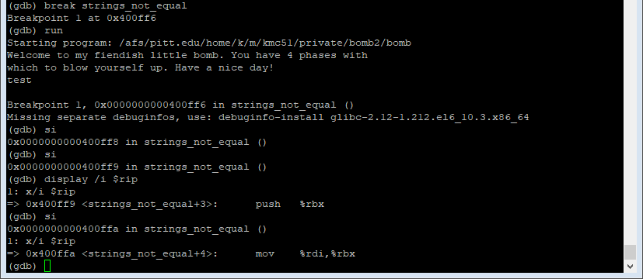

Slide 29
Notes
Guess it like you were to implement it
Draw the function call flow
1/0 values may indicate comparison
Keep a paper/Word doc to keep track
Sometimes things are implicit, but it shouldn’t matter

Slide 30
Good luck!
It’s possible (not easy) to get all answers w/o exploding the bomb

